Slide 1
CODELE
FOUNDATION EXAM STUDY HELPER

Slide 2




MEET THE TEAM
Daniel
Dylan/Lily
Nick/Fred
Lily/Fred
PM/Database
Frontend
API
Mobile

Slide 3
WHAT IS IT?
Codele is coding challenge application catered to UCF students to help practice for the foundation exam. Users can participate by answering daily coding questions and see how they stack up against other users.

Slide 4

















Technology Used
MongoDB
Express.js
React (TypeScript)
Node.js
Flutter
Database
Backend Framework
Frontend Framework
Runtime Environment
Mobile Framework
Digital Ocean
GoDaddy
SendGrid
JWT
SwaggerHub
Hosting Platform
Domain Provider
Email Service
Security/Authentication
API Documentation
Figma
Postman
Lighthouse
GitHub, Discord, Jira
Claude
Design / Prototyping
Testing
Accessibility Testing
Collab Tools
Helpers

Slide 5
PM/Database
As the Project Manager and Database Lead, I coordinated team tasks, tracked progress, and designed the presentation.
As Database I also designed and managed the MongoDB database, creating schemas, indexes, and relationships between collections to support features like user accounts, challenges, and leaderboards.

Slide 6
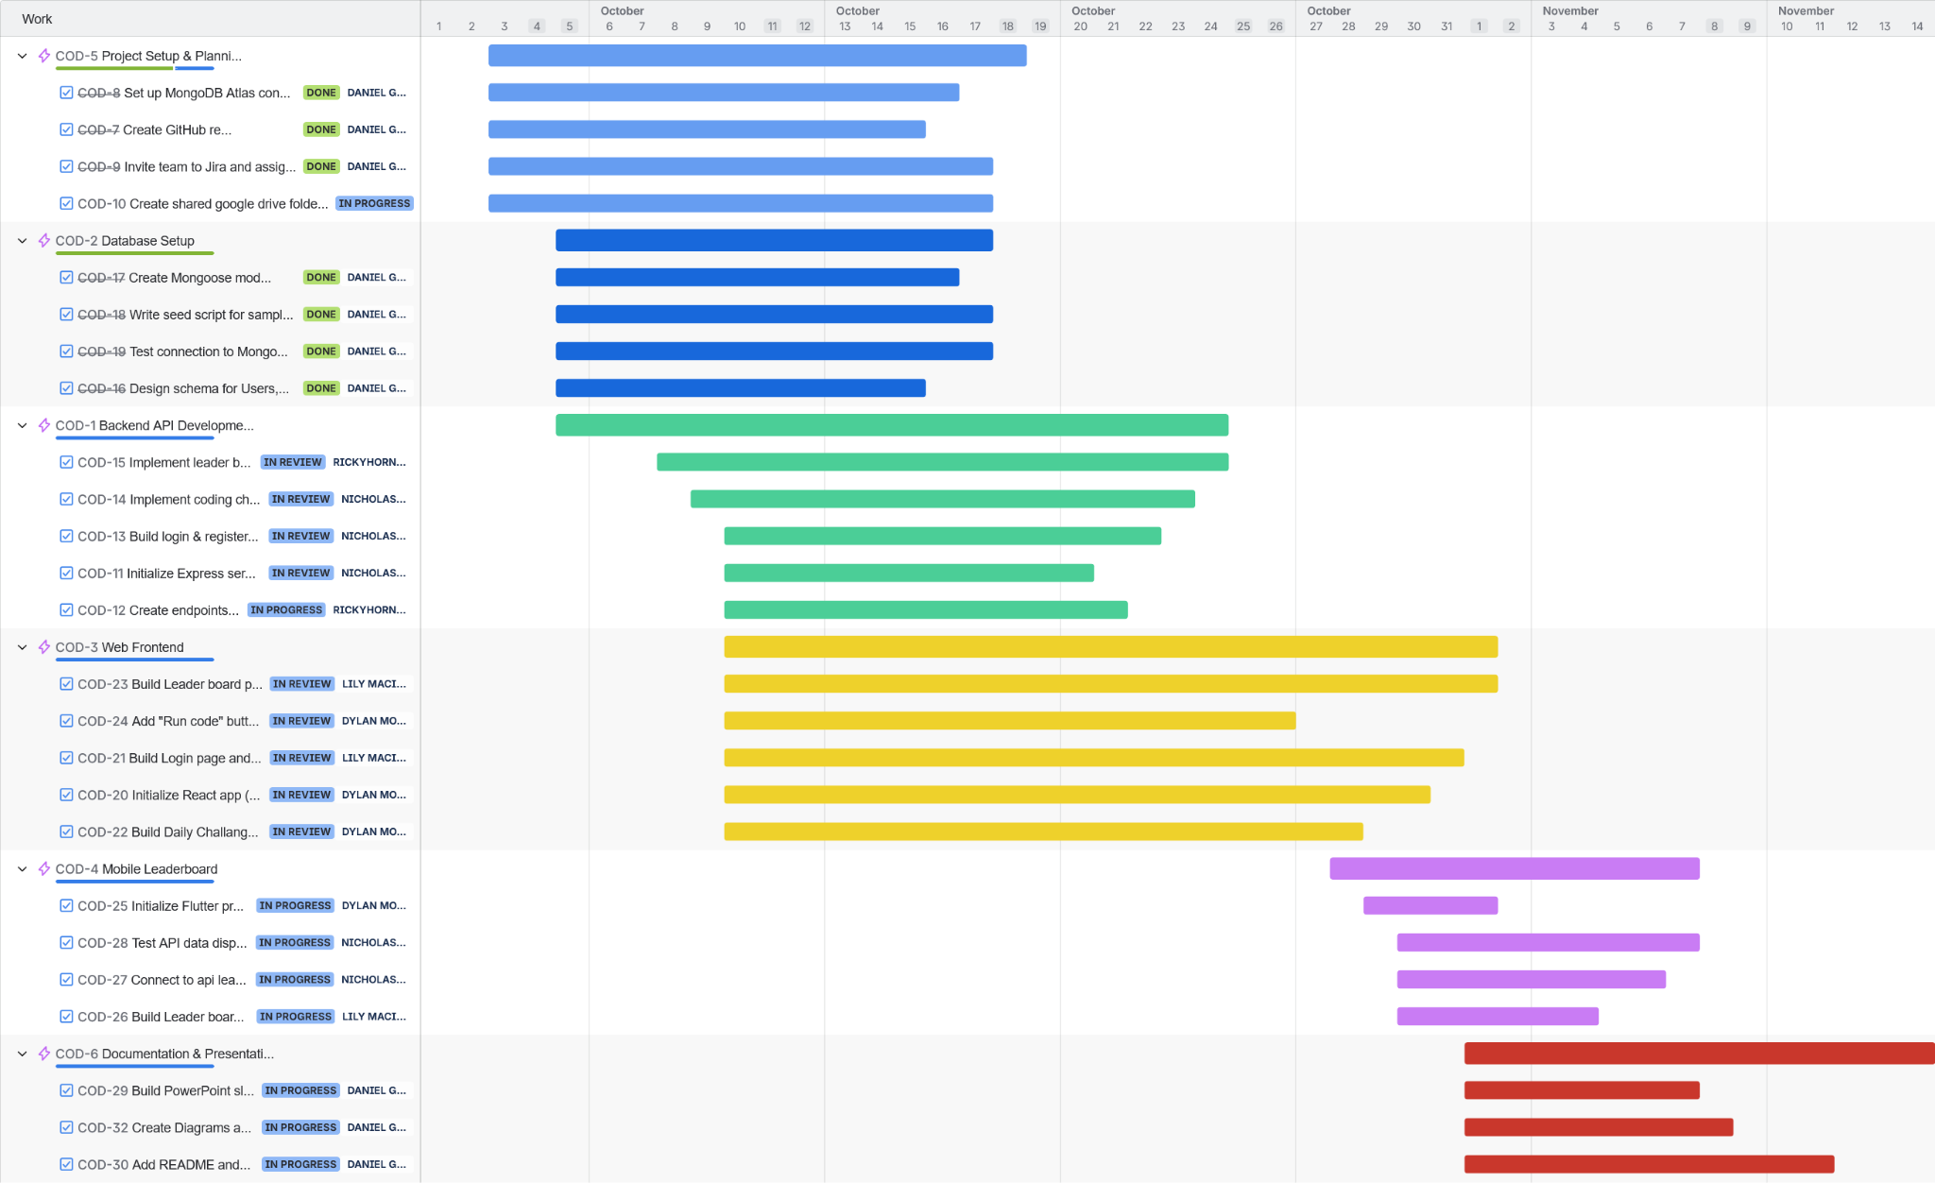
Gantt Chart

Slide 7
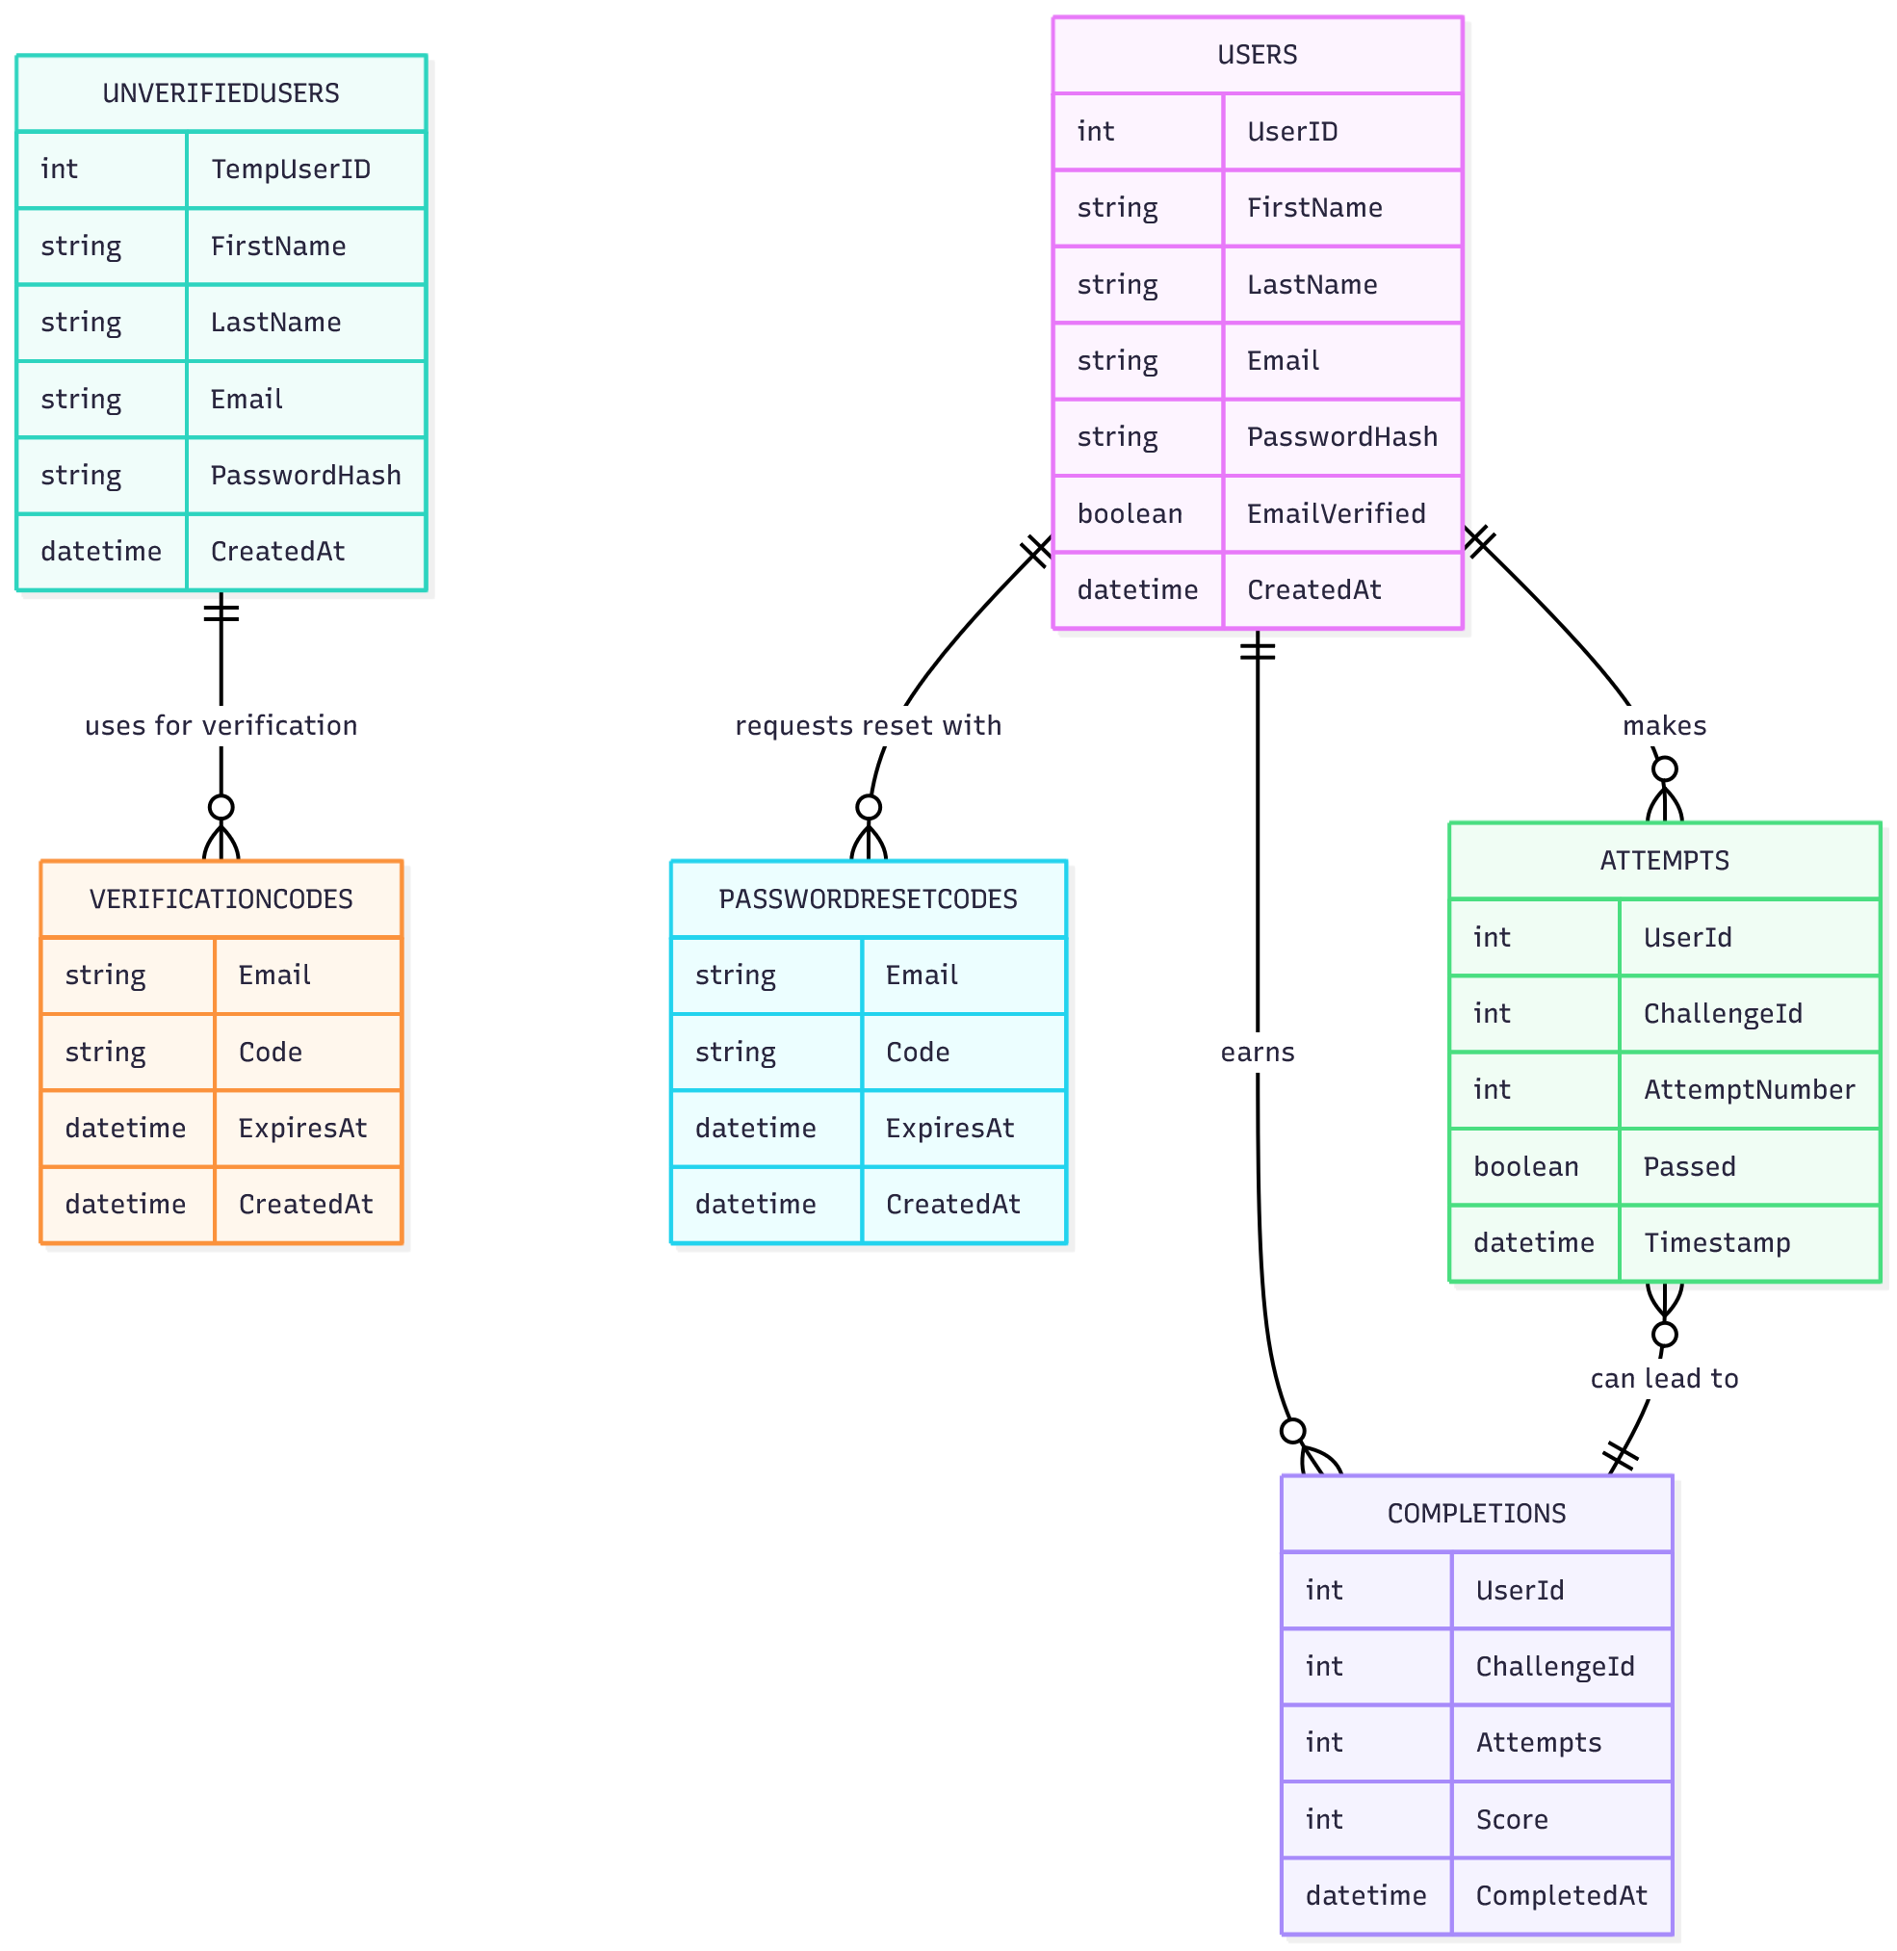
ERD
UnverifiedUsers stores new sign-ups who haven’t verified their email yet, keeping them separate from real users.
VerificationCodes stores the temporary codes and expirations used to confirm those unverified accounts.
Once a user verifies successfully, their data is moved into Users, and related unverified records/codes are deleted.
Only records in Users are allowed to log in, attempt challenges, and appear in leaderboard/completions.
Attempts, Completions, and PasswordResetCodes track how users interact with Codele, recording each try and successful solve for challenges, and securely handling forgotten passwords linked to verified accounts.

Slide 8
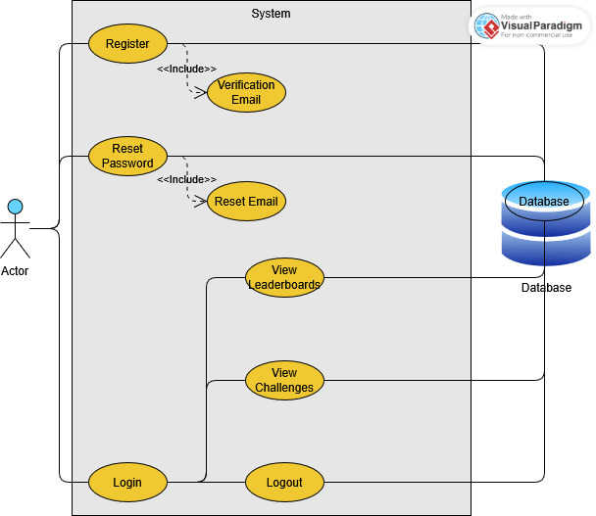
Use Case
The Actor represents the user who can register, log in, reset passwords, and access different features after logging in.
Register includes sending a Verification Email to confirm the user’s account.
Reset Password includes sending a Reset Email to allow users to create a new password.
Once logged in, users can View Challenges, View Leaderboards, and Logout.
The Database stores and retrieves user information, challenges, and leaderboard data for each action.

Slide 9
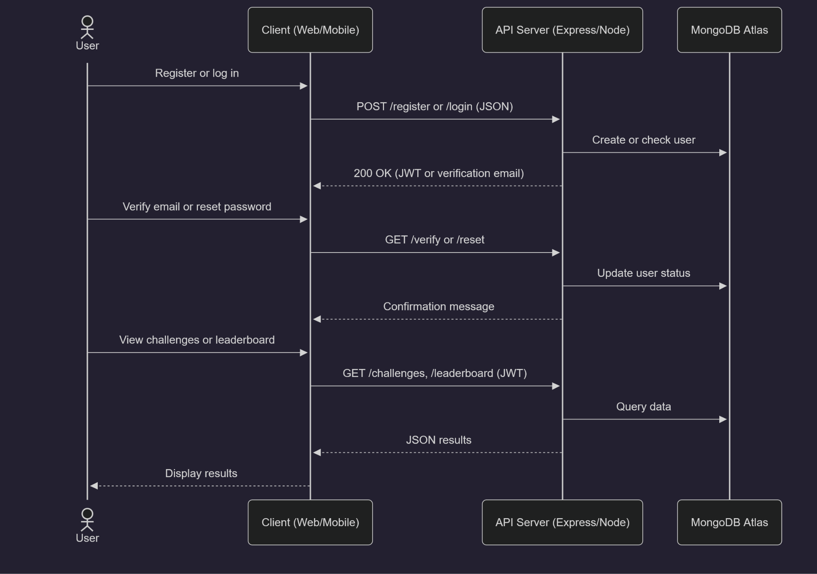
Sequence Diagram
This sequence diagram shows the main flow for both the web and mobile apps.
Users can register, verify their email, or log in.
The client sends JSON requests to the Express API, which interacts with our remote MongoDB Atlas database and returns JWTs or data responses like the leaderboard

Slide 10
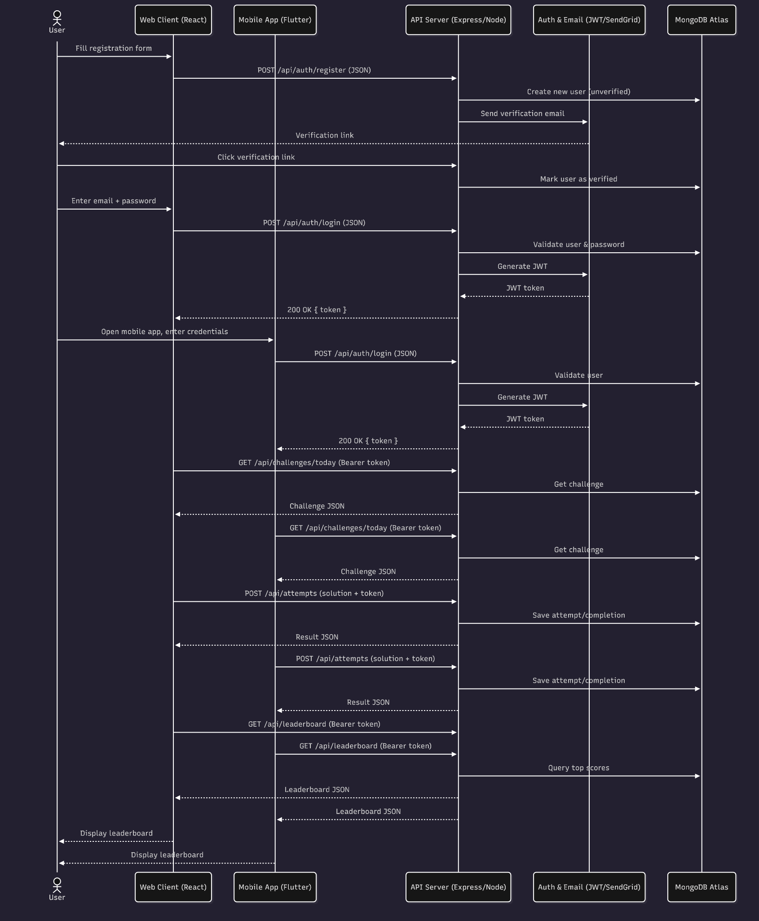
Full Sequence Diagram

Slide 11
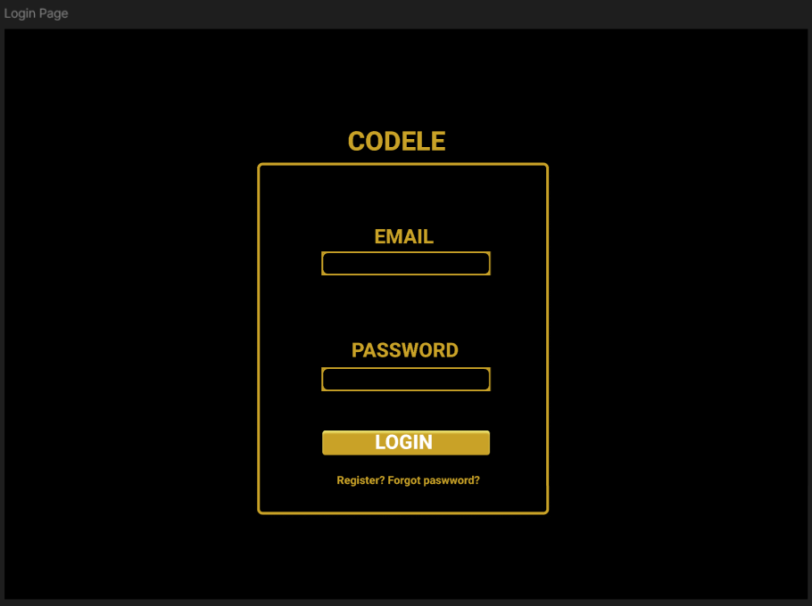
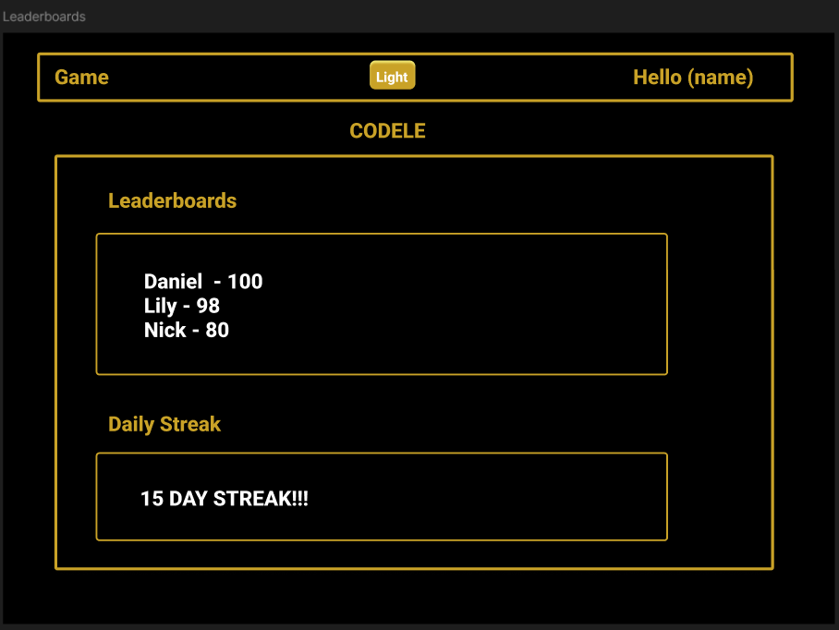
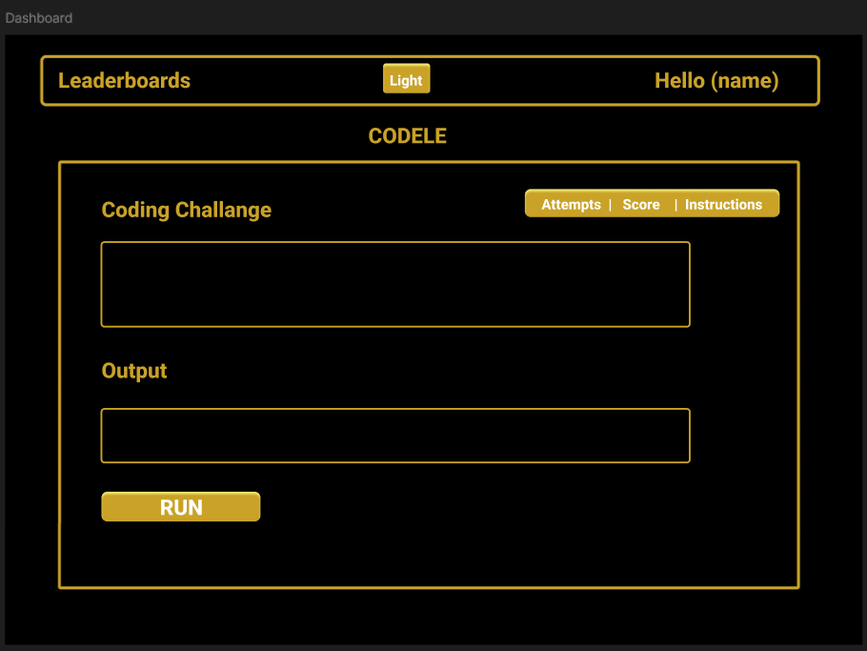
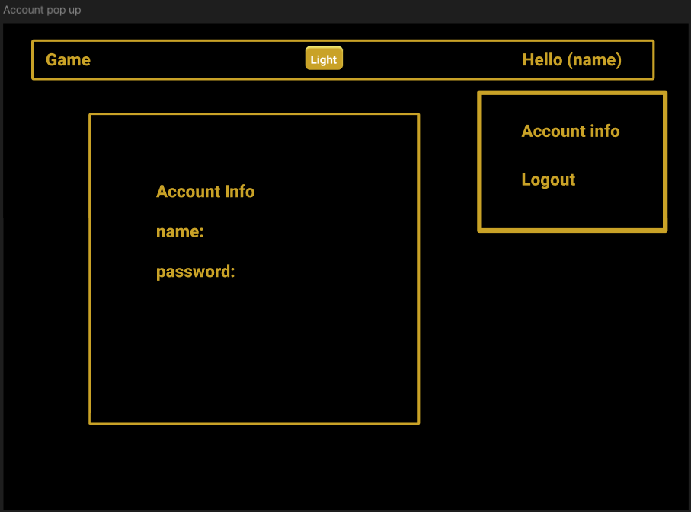
Figma Web
Figma Web Demo

Slide 12
API
In charge of connecting the frontend and backend to each other using JavaScript
Also connecting SendGrid to the server to be able to send user emails
Created Unit Tests for the API endpoints

Slide 13
API DEMO
SwaggerHub link here

Slide 14
UNIT TESTING

Slide 15
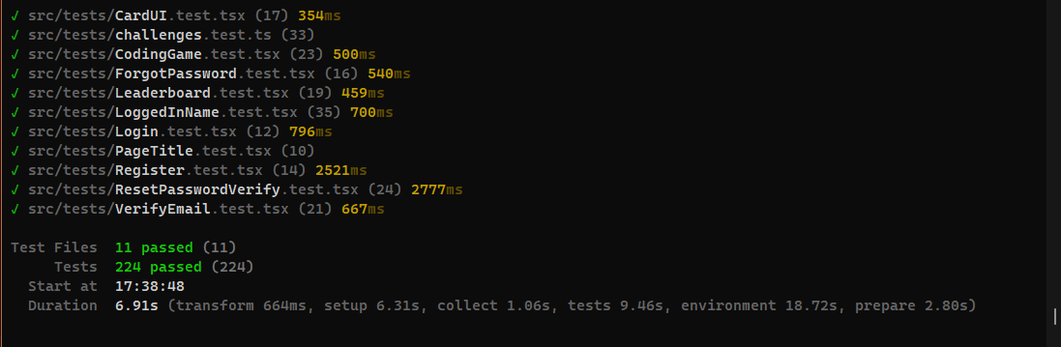
Frontend

Slide 16
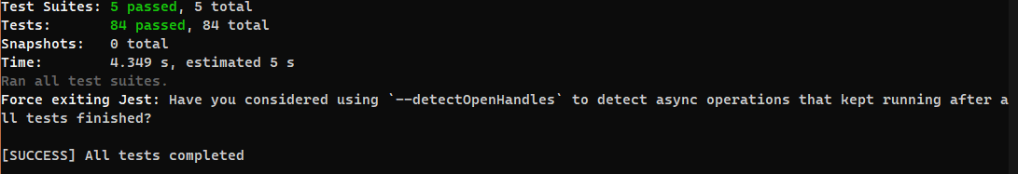
Backend

Slide 17
FRONTEND
Built the user interface for login, register, viewing challenges, leaderboard.
Handled user experience and design, ensuring pages were responsive, easy to navigate, and connected smoothly to the backend API.

Slide 18
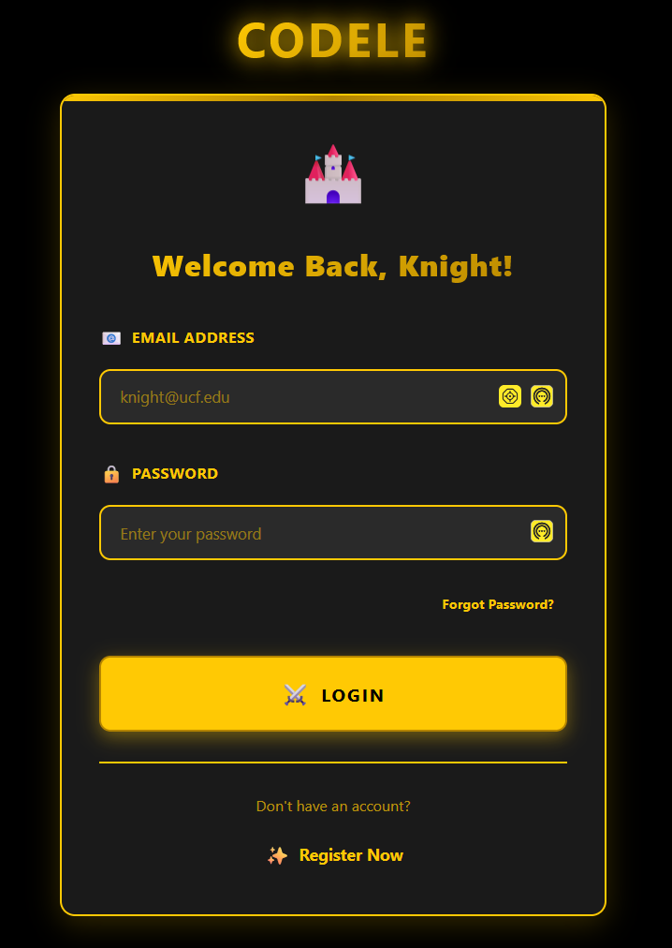
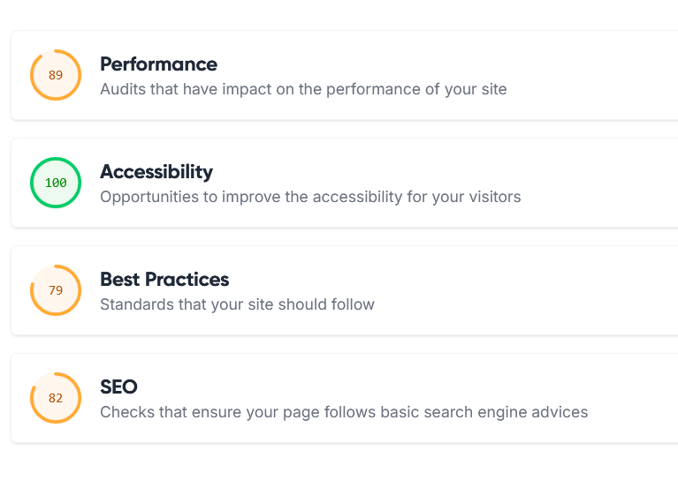
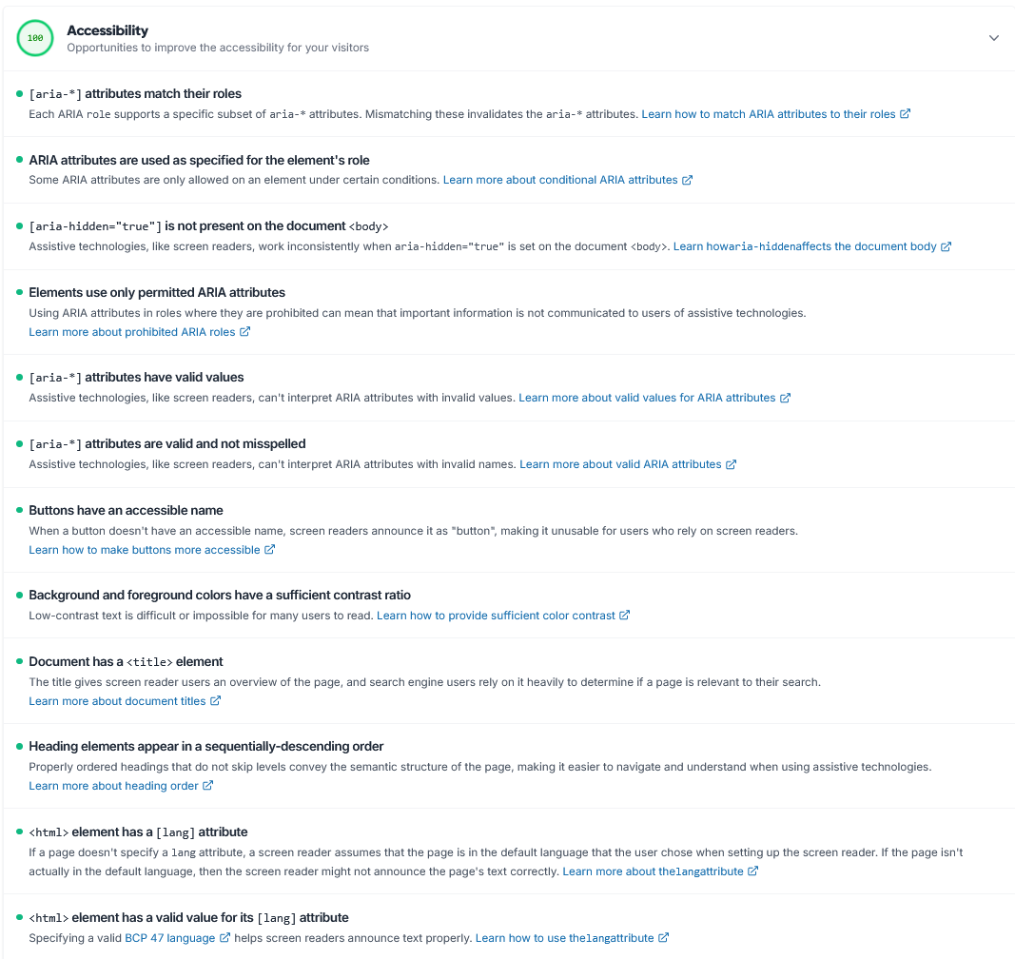
LightHouse Login

Slide 19
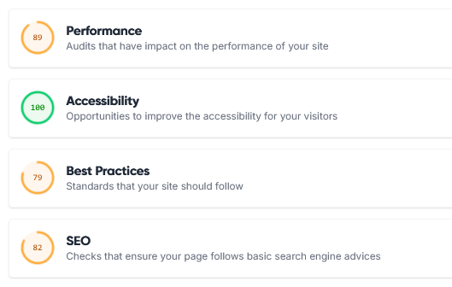
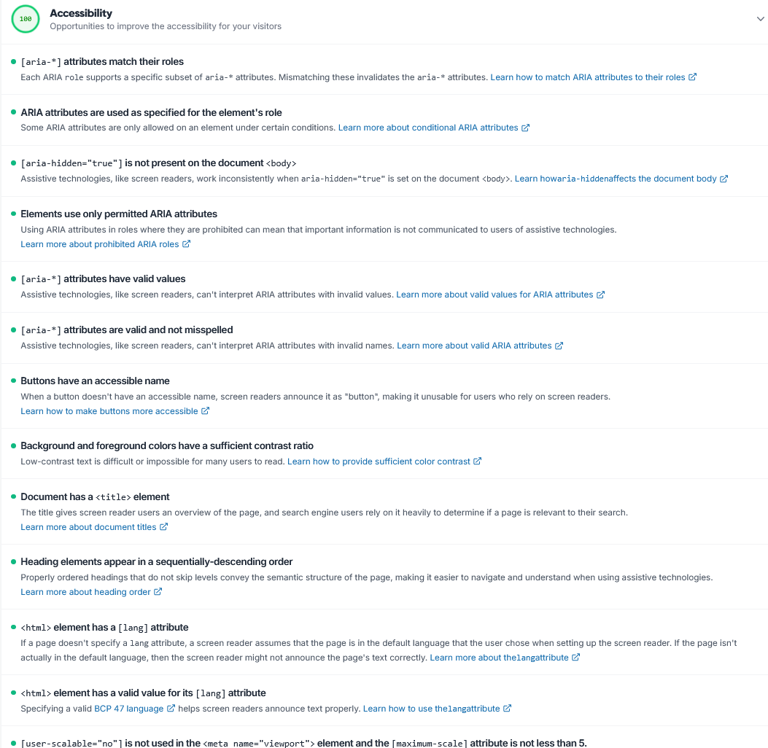
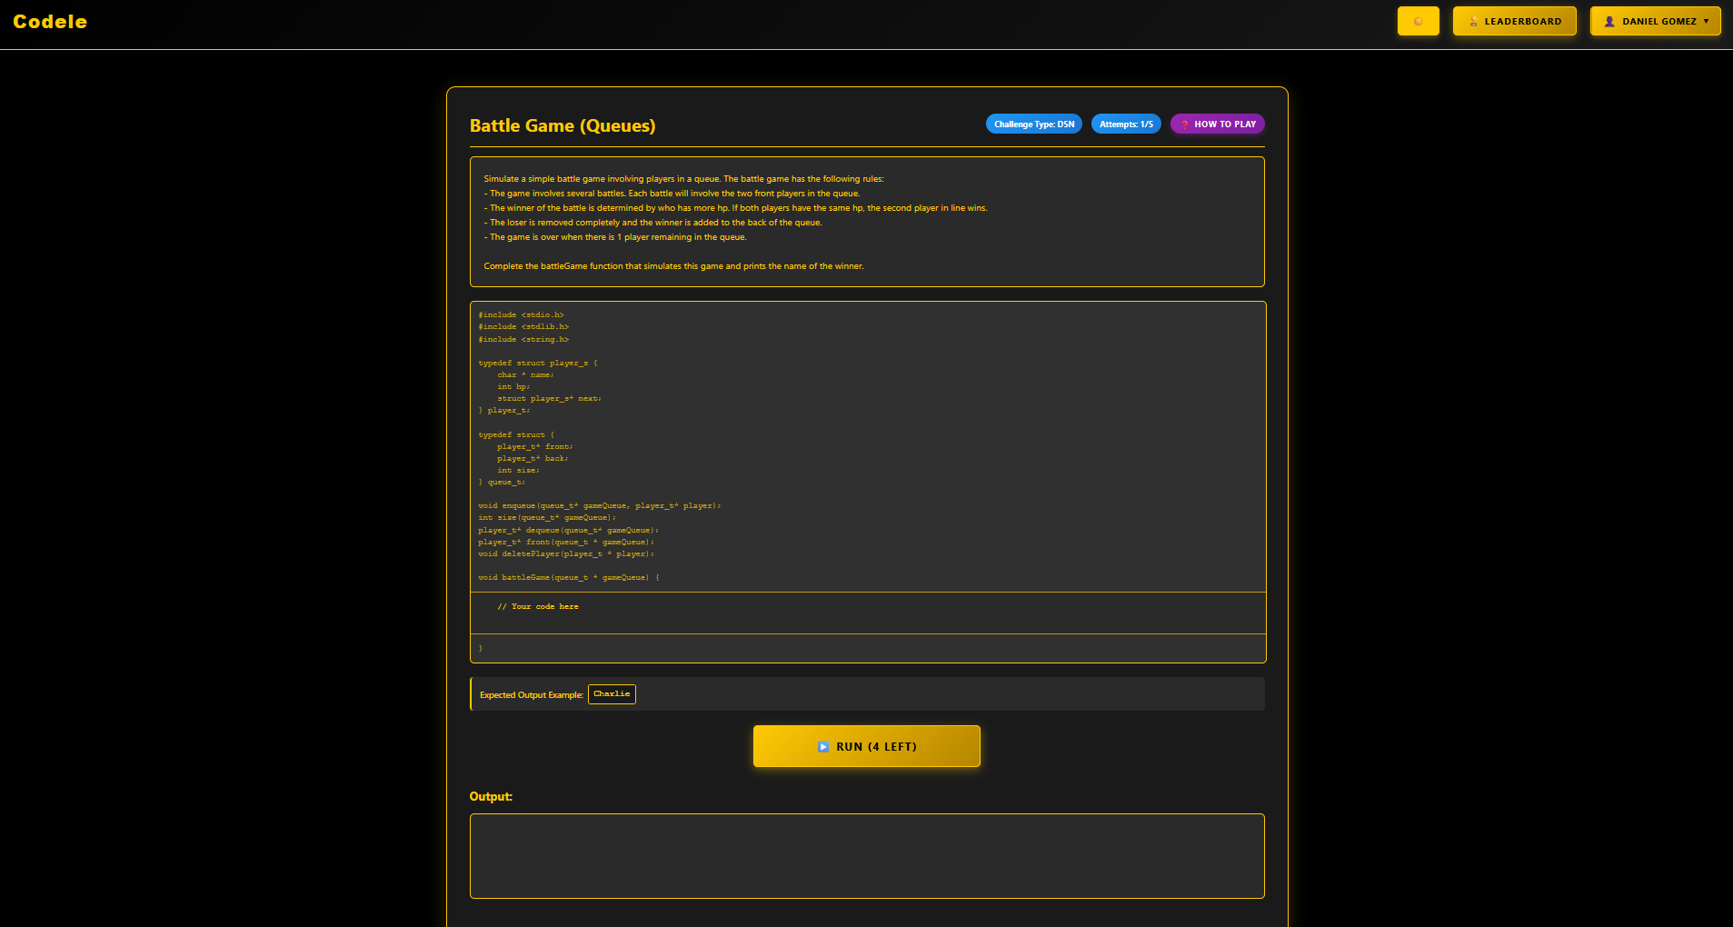
LightHouse Dashboard

Slide 20
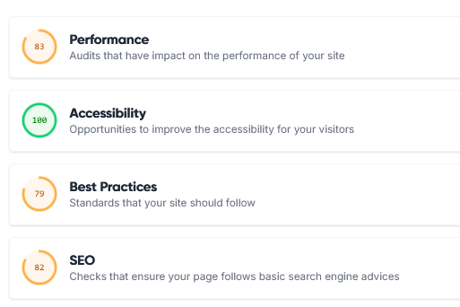
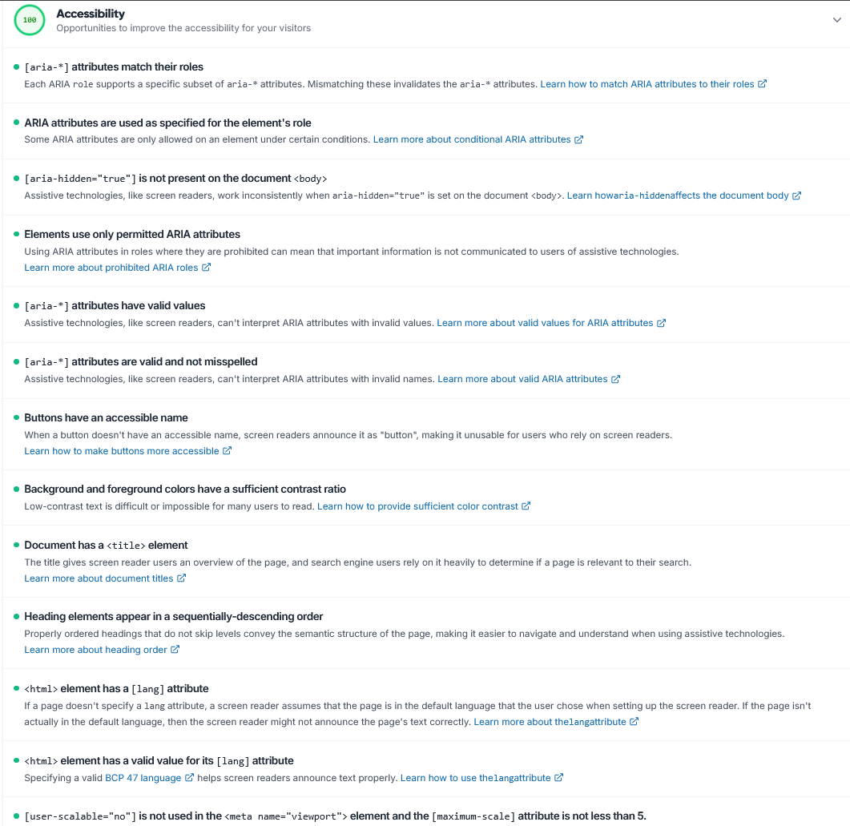
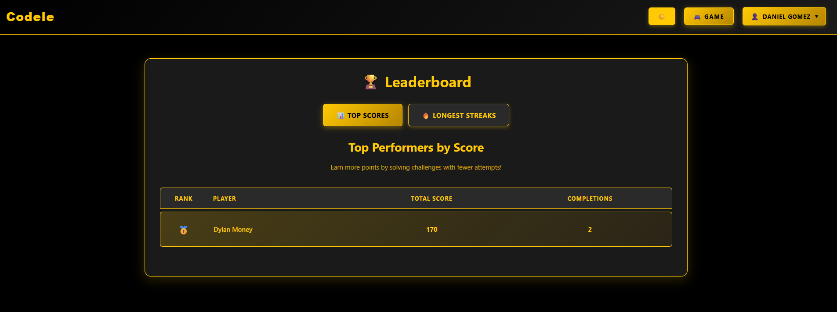
LightHouse Leaderboards

Slide 21
MOBILE
Learned flutter framework and dart language.
Developed a reusable app theme and widgets for faster development and design consistency.
Adapted web UI for a mobile interface.
Connected to API endpoints.

Slide 22
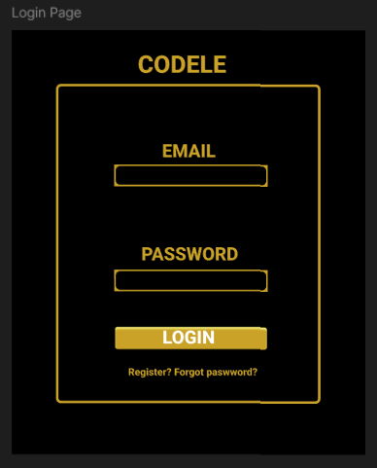
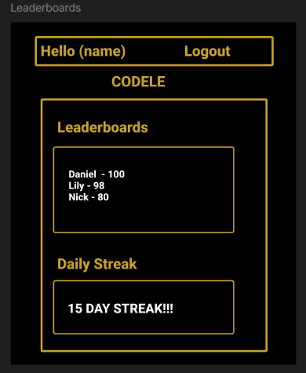
Figma Mobile
Figma Mobile Demo

Slide 23
MOBILE UNIT TESTING

Slide 24
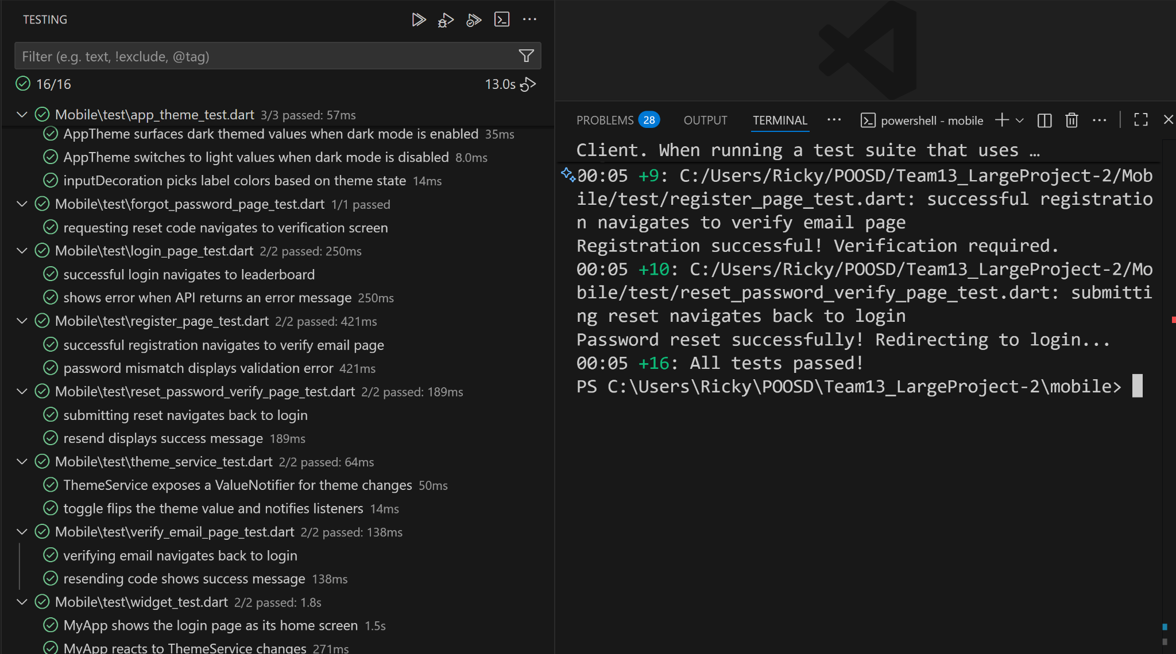

Slide 25
WEB APP DEMO
Codele
Answer while(size(gameQueue) > 1) { // 1 pt
player_t * p1 = dequeue(gameQueue); // 1 pt
player_t * p2 = dequeue(gameQueue); // 1 pt
if(p1->hp > p2->hp) { // 1 pt
deletePlayer(p2); // 1 pt
enqueue(gameQueue, p1); // 1 pt
} else { deletePlayer(p1); // 1 pt
enqueue(gameQueue, p2); // 1 pt
} } player_t * winner = front(gameQueue); // 1 pt
printf(winner->name); // 1 pt

Slide 26
MOBILE APP DEMO
Mobile app demo

Slide 27
Thanks!
Do you have any questions?

